Slide 1
What’s Wrong With Green?

Slide 2
Apple App Store
800,000
54
64,567
apps
lines of JavaScript
apps downloaded
(and rising)

Slide 3
App ratings

Slide 4
App ratings

Slide 5
1 …
5
#1 Games
#2 Weather
…
…
…
#21 Business
#22 Catalogs
2% | 1% | 3% | 8% | 14% | 17% | 22% | 20% | 7%
1% | 1% | 4% | 11% | 21% | 16% | 20% | 15% | 8%
2% | 2% | 4% | 7% | 11% | 15% | 16% | 16% | 12%
3% | 3% | 5% | 9% | 14% | 14% | 15% | 19% | 9%
3% | 1% | 5% | 8% | 11% | 12% | 15% | 16% | 11%
1% | 2% | 4% | 8% | 14% | 11% | 11% | 13% | 16%
3% | 1% | 6% | 9% | 14% | 16% | 16% | 14% | 9%
2% | 2% | 3% | 8% | 15% | 15% | 17% | 11% | 12%
3% | 1% | 5% | 9% | 15% | 13% | 12% | 15% | 12%
2% | 1% | 2% | 5% | 11% | 13% | 17% | 13% | 12%
4% | 2% | 5% | 6% | 8% | 6% | 18% | 13% | 12%
3% | 1% | 5% | 10% | 16% | 13% | 16% | 14% | 9%
4% | 1% | 2% | 5% | 11% | 13% | 15% | 12% | 13%
3% | 2% | 4% | 7% | 12% | 15% | 12% | 12% | 13%
2% | 2% | 6% | 13% | 17% | 14% | 12% | 10% | 10%
2% | 1% | 4% | 8% | 12% | 12% | 13% | 10% | 12%
3% | 2% | 6% | 11% | 14% | 13% | 12% | 9% | 10%
3% | 3% | 5% | 9% | 13% | 13% | 12% | 10% | 11%
4% | 2% | 6% | 10% | 12% | 11% | 10% | 10% | 11%
4% | 3% | 7% | 11% | 13% | 17% | 14% | 10% | 6%
3% | 1% | 4% | 6% | 7% | 8% | 9% | 7% | 13%
4% | 1% | 6% | 10% | 10% | 13% | 5% | 6%

Slide 6
Average price
#1 Entertainment - £1.59
#2 Games - £2.00
#21 Business - £7.28
#22 Medical - £7.66

Slide 7
800,000
54
64,567
36
258,989
25.6
105
6,658,560,189
apps
lines of JavaScript
apps downloaded
lines of JavaScript
screenshots
gigabytes
lines of C#
pixels

Slide 8
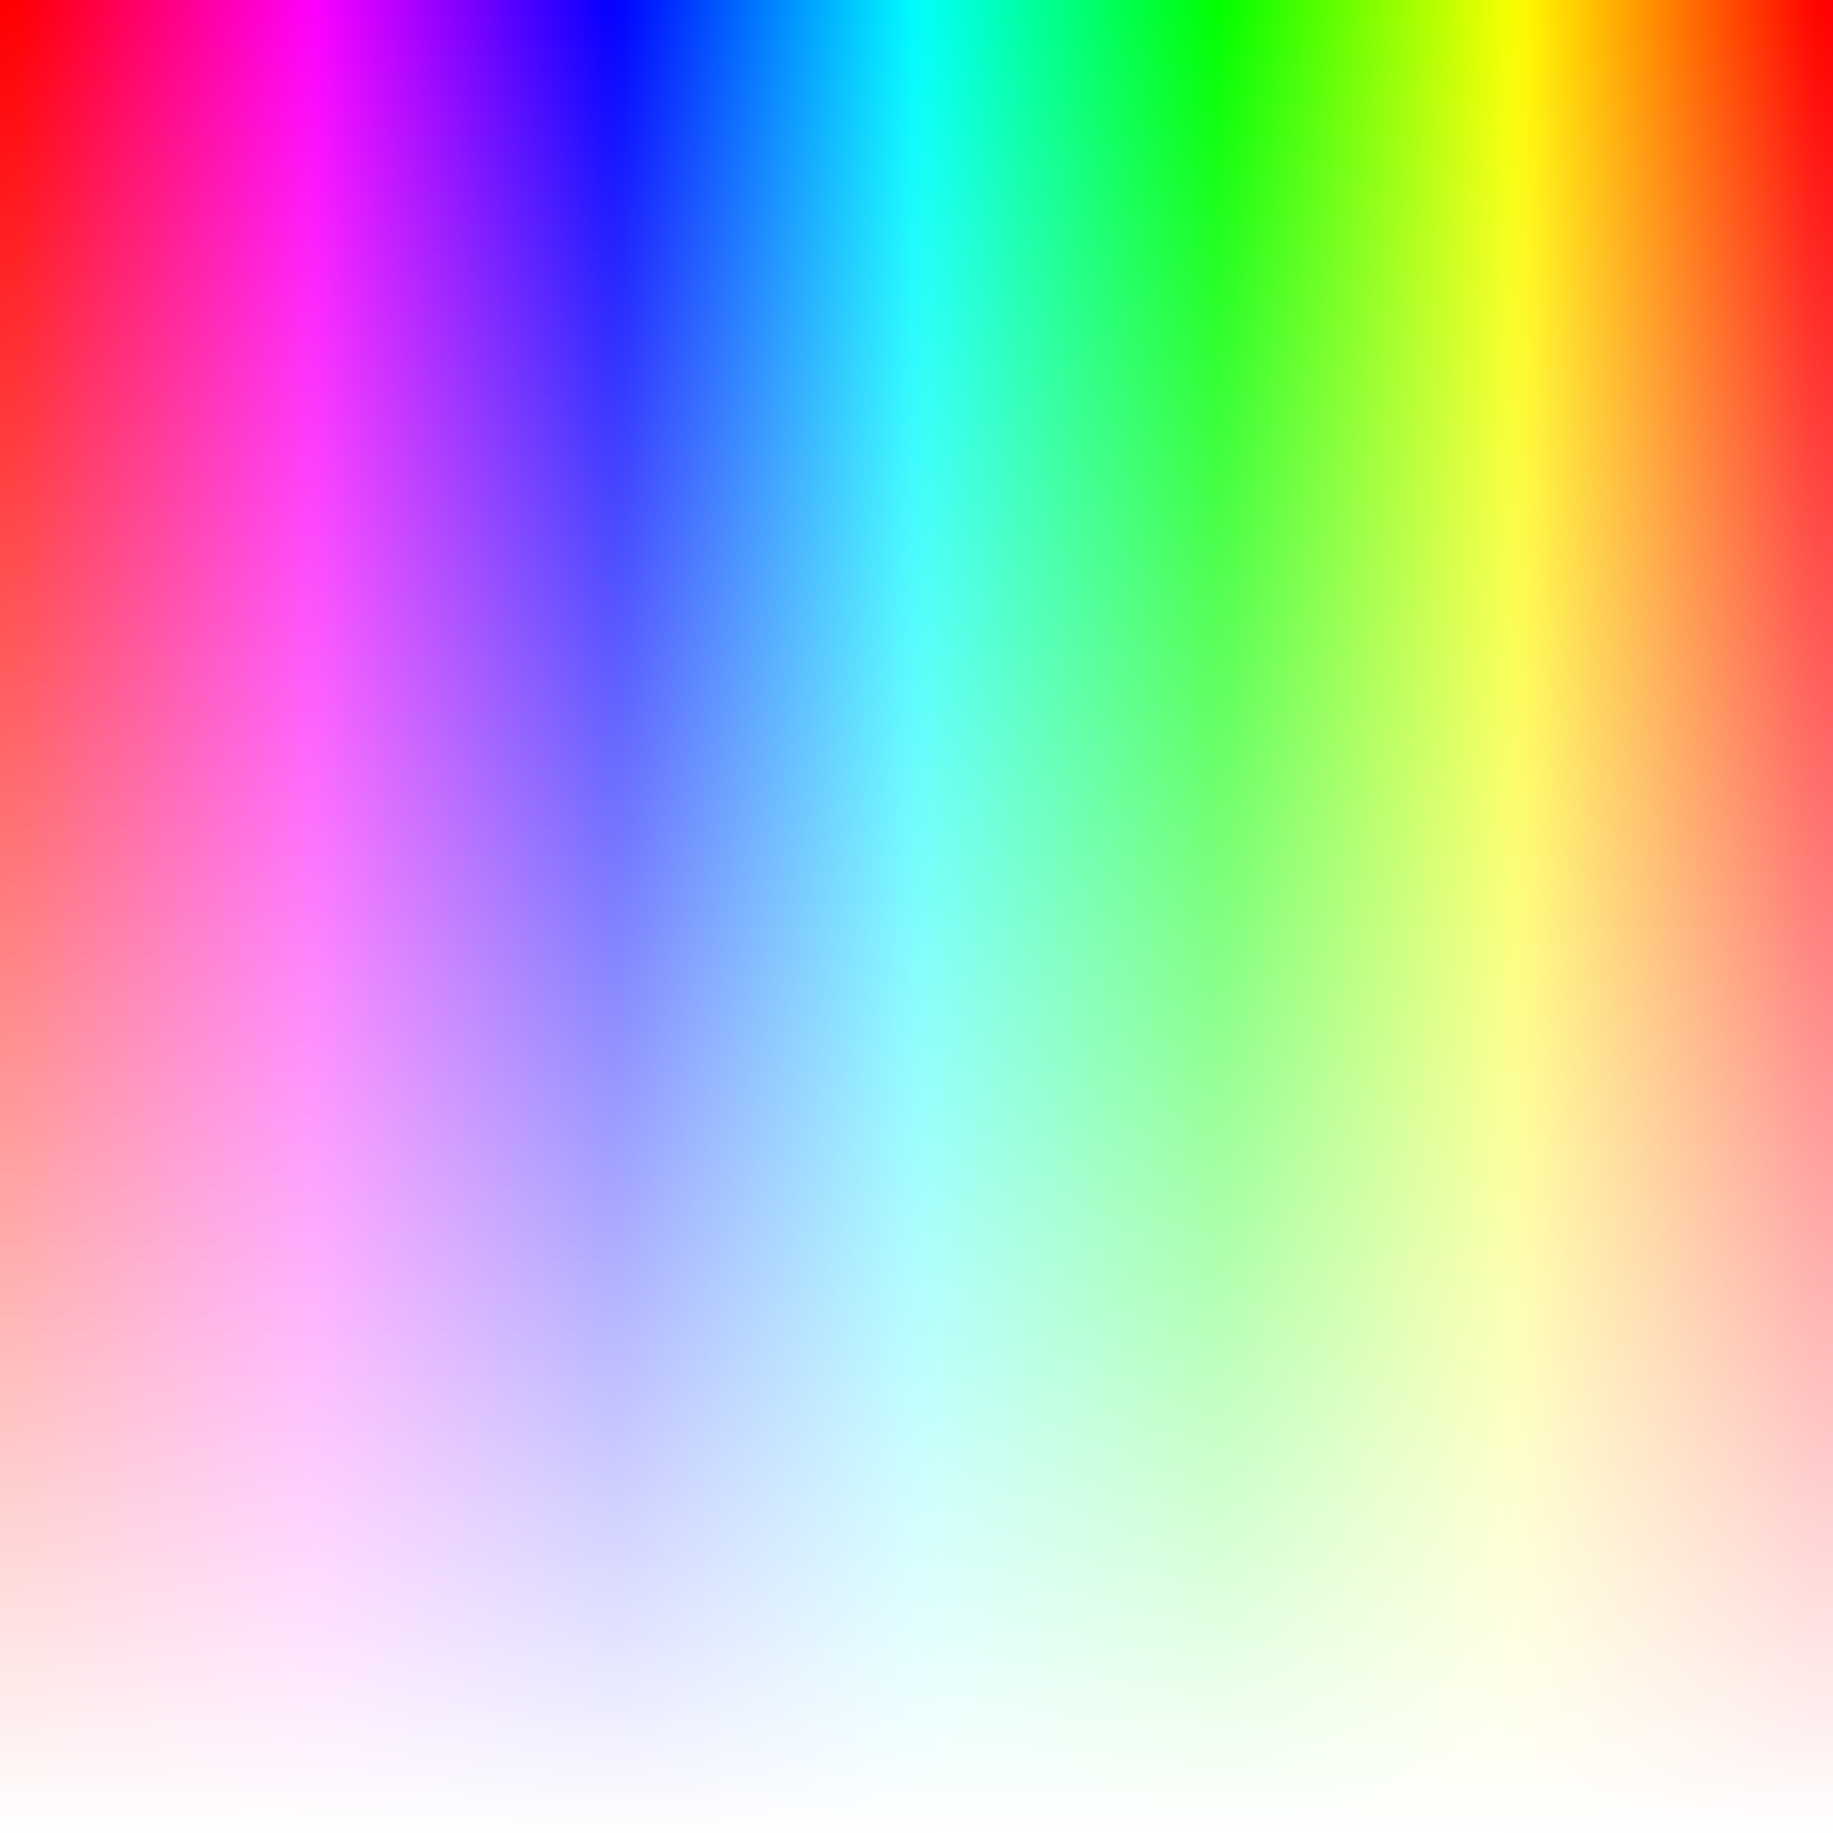
Color signature

Slide 9
Color signature
Entertainment
Business

Slide 10



Brightness
Navigation
Sports
Education

Slide 11


Saturation
Books
Finance
Food & Drink

Slide 12
What’s Wrong With Green?
@ColinEberhardt

Slide 13
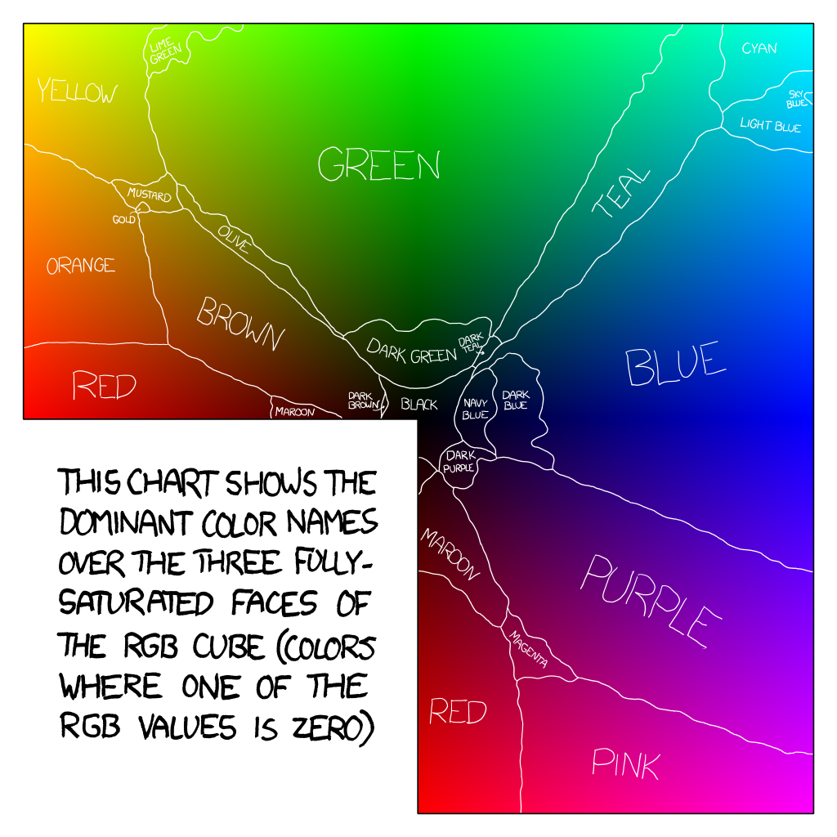
http://xkcd.com/color/rgb/

Slide 14


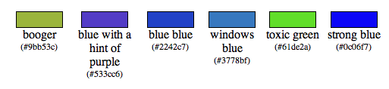
11
Puke
Puke brown
Puke yellow
Baby puke green
Baby shit brown
http://xkcd.com/color/rgb/

